Slide 1
Disclaimer
Thank you for your interest in using Google Cloud training material. We are excited about the content we are able to provide you (collectively, “Teaching Resources”) and hope you are too.
By using Teaching Resources, you agree to be bound by all of the following terms, as well as the Google terms of service and the Google privacy policy. Unless otherwise specified, terms used below will have the meanings described in the Google terms of service.
Educational Use Only. Teaching Resources is intended only for use teaching courses at regionally accredited or higher learning institutions. The content may be adapted, customize, remixed, and shared for educational use. Content may not be distributed, or otherwise exploited for any commercial purpose, commercial advantage, or private monetary compensation.
Attribution Requirements. If you distribute, publicly perform, display, transmit, publish, or otherwise make available any Teaching Resources or any derivative works thereof, you must attribute the material you use back to the Teaching Resources, but not in any way that suggests Google, any of its affiliates, or any of its third party content providers endorse you or your use of such materials. If you adapt, remix, or customize the Teaching Resources please include the following text on each edited slide: “The original content was provided by Google LLC and modified for the purpose of the course, without input or endorsement from Google LLC.”
Descriptions of Google products, services, infrastructure and processes contained in the Teaching Resources are descriptions for teaching and learning purposes only and do not constitute a guarantee, promise, or representation of accuracy by Google. Pricing, availability or features of Google Cloud products and services described in the Teaching Resources may change.
Copyright Google LLC. For educational purposes in accordance with the terms of use set forth on the program Website.

Slide 2
Start with a Solid Platform
Copyright Google LLC. For educational purposes in accordance with the terms of use set forth on the program Website.
Notes:
Hi, I’m ______.
Welcome to the module Start with a Solid Platform.

Slide 3
Course map
Module 1
Module 2
Module 3
Module 4
Module 5
So, What’s the Cloud Anyway?
Start with a Solid Platform
Use Google Cloud to Build Your Apps
Where Do I Store This Stuff?
There’s an API for That!
Module 6
Module 7
Module 8
Module 9
Module 10
You Can’t Secure the Cloud, Right?
It Helps to Network
Let Google Keep an Eye on Things
You Have the Data, but What Are You Doing with It?
Let Machines Do the Work
Google Cloud skills badges
Copyright Google LLC. For educational purposes in accordance with the terms of use set forth on the program Website.
Notes:
In the first module, we discussed what Cloud is and why it’s a technological and business game changer. Start with a Solid Platform is the second module of the Google Cloud Computing Foundations course, and will look at the different ways that you can interact with Google Cloud.

Slide 4

Learn how to … (1/2)
Describe the different ways a user can interact with Google Cloud
Discuss how to navigate the Google Cloud environment with the Cloud Console
Explain the purpose and process of creating Google Cloud projects
Explain how billing works in Google Cloud
Detail how to install and set up the Cloud SDK
Copyright Google LLC. For educational purposes in accordance with the terms of use set forth on the program Website.
Notes:
The objective of this module is for you to be able to describe the different ways a user can interact with Google Cloud.
The specific learning objectives to achieve this include you being able to discuss how to navigate the Google Cloud environment with the Cloud Console, explain the purpose and process of creating Google Cloud projects, and explain how billing works. You’ll also be able to detail how to install and set up the Cloud Software Development Kit, or Cloud SDK.

Slide 5
Learn how to … (2/2)
Describe the different use cases for using Cloud Shell and the Cloud Shell code editor
Describe how APIs work and how to test Google APIs using Google APIs Explorer
Discuss how to manage services running on Google Cloud directly from a mobile device
Copyright Google LLC. For educational purposes in accordance with the terms of use set forth on the program Website.
Notes:
You’ll also be able to describe how Cloud Shell can be used as an alternative way to access your cloud resources directly from your browser, and how the services that make up Google Cloud offer APIs so that code that you write can control them. Finally, you’ll be able to discuss how you can manage services from a mobile app.

Slide 6
Agenda (1/2)
The Cloud Console
Understanding Projects
Billing in Google Cloud
Install and Configure the Cloud SDK
Use Cloud Shell
Lab: A Tour of Qwiklabs and Google Cloud
Copyright Google LLC. For educational purposes in accordance with the terms of use set forth on the program Website.
Notes:
This module starts by exploring the Cloud Console followed by an introduction to projects and billing. The topics that follow address installing and configuring the Cloud SDK and how to use Cloud Shell as an alternative to the Cloud SDK. We’ll then complete our first lab, where we’ll take our first steps with Google Cloud by getting hands-on practice with the Cloud Console.

Slide 7
Agenda (2/2)
Lab: Getting Started with Cloud Shell and gcloud
Google Cloud APIs
Cloud Console Mobile App
Quiz
Summary
Copyright Google LLC. For educational purposes in accordance with the terms of use set forth on the program Website.
Notes:
We’ll then complete a second lab where we’ll apply a range of gcloud commands within Google Cloud Shell Connect to storage services hosted on Google Cloud. The topics that follow introduce Google Cloud APIs as well as the Cloud Console mobile app, before a short quiz and module recap.

Slide 8
Agenda
The Cloud Console
Understanding Projects
Billing in Google Cloud
Install and Configure the Cloud SDK
Use Cloud Shell
Lab: A Tour of Qwiklabs and Google Cloud
Copyright Google LLC. For educational purposes in accordance with the terms of use set forth on the program Website.
Notes:
Let’s start with our first topic, the Cloud Console.

Slide 9

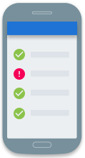
There are four ways to interact with Google Cloud
>_
Google Cloud Console
Web user interface
Cloud SDK and Cloud Shell
Command-line interface
REST-based
API
For custom applications
Cloud Console mobile app
For iOS and Android
Copyright Google LLC. For educational purposes in accordance with the terms of use set forth on the program Website.
Notes:
There are four ways you can interact with Google Cloud, and we’ll talk about each in turn: the Cloud Console, the Cloud SDK and Cloud Shell, APIs, and the Cloud Console mobile app.

Slide 10
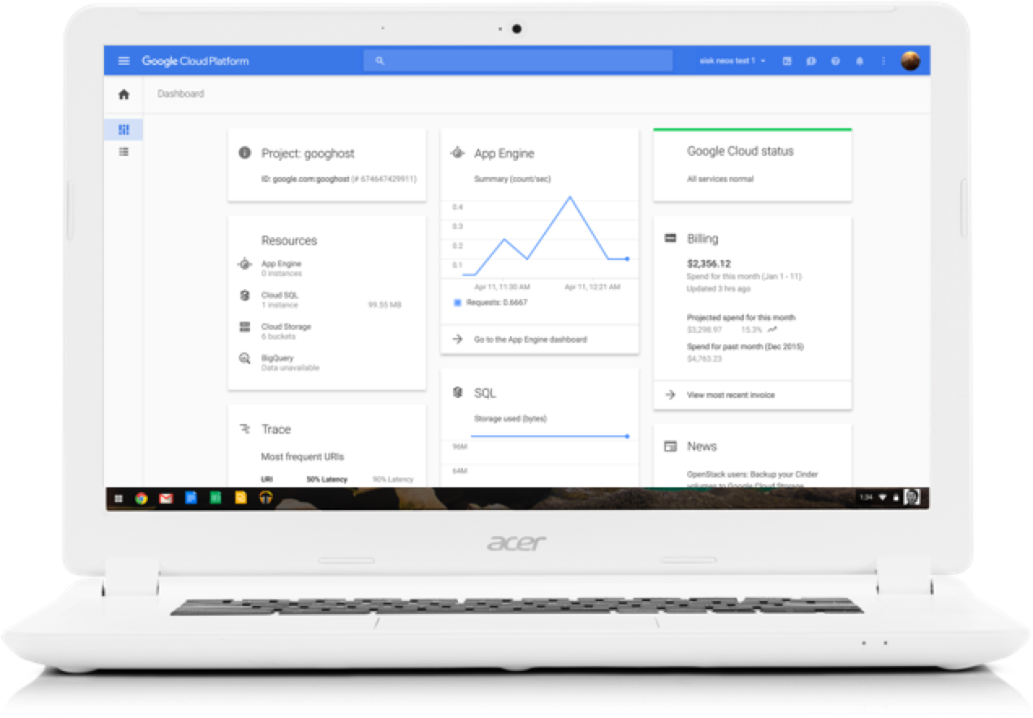
The Cloud Console provides a web-based GUI for you to manage Google Cloud projects and resources
Centralized console for all project data.
Execute common tasks using simple mouse clicks.
Manage and create projects.
Access developer tools:
Cloud Source Repositories
Cloud SDK
Cloud Shell
Access to product APIs.
Copyright Google LLC. For educational purposes in accordance with the terms of use set forth on the program Website.
Notes:
The Cloud Console serves as a centralized console for all of your project data, and lets you execute common tasks using simple mouse clicks with no need to remember commands or avoid typos.
When you use the Cloud Console, the resources that you create are done so in the context of a specific project. You can create multiple projects, so you can use projects to separate your work in whatever way makes sense for you. For example, you might start a new project if you want to make sure only certain team members can access the resources in that project, while all team members can continue to access resources in another project.
The Cloud Console is also great for developers. Cloud Source Repositories provides Git version control to support collaborative development of any application or service.
The Cloud SDK is a set of command-line tools for Google Cloud. You can run these tools interactively or in your automated scripts.
Cloud Shell also provides you with command-line access to your cloud resources directly from your browser, but without having to install the Cloud SDK or other tools on your system. The utilities you need are always available, up to date and fully authenticated when you need them.
The Cloud SDK and Cloud Shell will be discussed in more detail later in this module.
The Cloud SDK includes client libraries that enable you to easily create and manage resources. Google Cloud client libraries expose APIs for two main purposes. App APIs provide access to services and admin APIs offer functionality for resource management.

Slide 11
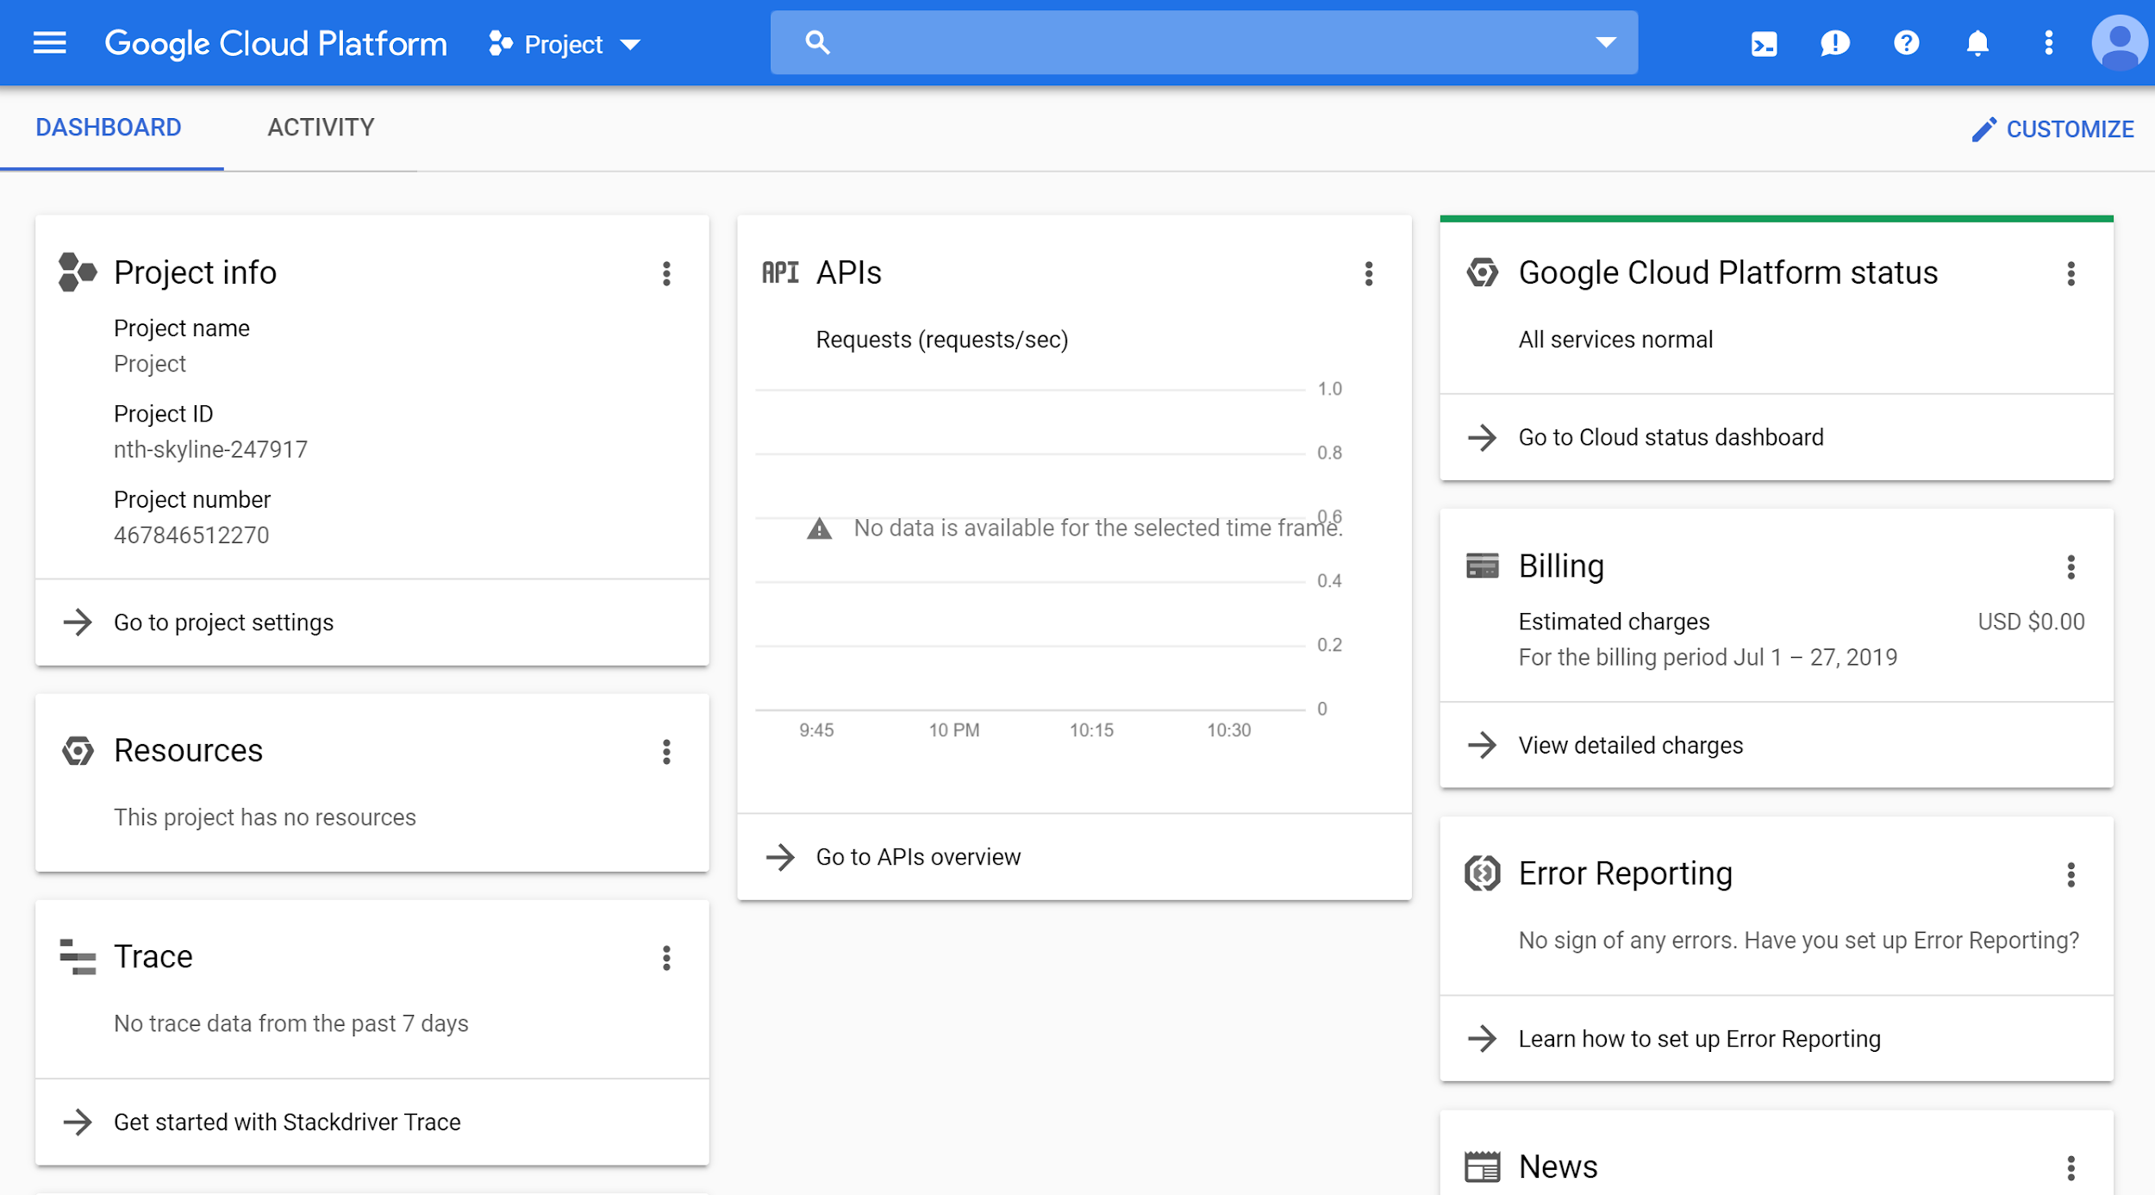
Logging in to the Cloud Console
Copyright Google LLC. For educational purposes in accordance with the terms of use set forth on the program Website.
Notes:
From a browser, go to console.cloud.google.com. If you haven’t already logged into your Google account, the system will prompt you to enter your credentials. After you log in, the Cloud Console will display the details of your default project.

Slide 12
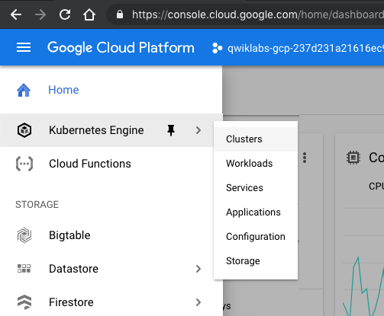
Interacting with the Cloud Console
Copyright Google LLC. For educational purposes in accordance with the terms of use set forth on the program Website.
Notes:
All Google Cloud services are accessible through the simple menu button in the top-left corner. You can pin frequently used services to this menu.

Slide 13
Agenda
The Cloud Console
Understanding Projects
Billing in Google Cloud
Install and Configure the Cloud SDK
Use Cloud Shell
Lab: A Tour of Qwiklabs and Google Cloud
Copyright Google LLC. For educational purposes in accordance with the terms of use set forth on the program Website.
Notes:
All Google Cloud resources that you allocate and use must belong to a Google Cloud project. You’ll learn more about projects in this topic.

Slide 14
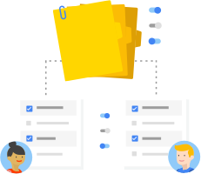
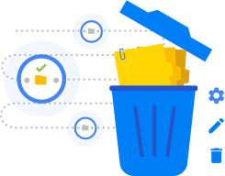
Every Google Cloud service you use is associated
with a project
Enable services and APIs.
Enable billing.
Manage permissions and credentials.
Track resource and quota usage.
Programmatically manage your projects in Google Cloud.
Copyright Google LLC. For educational purposes in accordance with the terms of use set forth on the program Website.
Notes:
Projects are the basis for enabling and using Google Cloud services, like managing APIs, enabling billing, adding and removing collaborators, and enabling other Google services. Each project is a separate account, and each resource belongs to exactly one. Projects can have different owners and users. They’re billed separately, and they’re managed separately.
Resource Manager provides ways for you to programmatically manage your projects in Google Cloud. You can access Resource Manager through an RPC API or REST API. With these APIs, you can get a list of all projects associated with an account, create new projects, update existing projects, and delete projects. You can also undelete, or recover, projects that you want to restore.

Slide 15
Projects have three identifying attributes
Project ID
Project name
Project number
Globally unique
Need not be unique
Globally unique
Assigned by Google Cloud but mutable during creation
Chosen by you
Assigned by Google Cloud
Immutable after creation
Mutable
Immutable
Copyright Google LLC. For educational purposes in accordance with the terms of use set forth on the program Website.
Notes:
Each Google Cloud project has a name and project ID that you assign. The project ID is a permanent, unchangeable identifier, and it has to be unique across Google Cloud. While a Project ID will be generated automatically, you can edit it. However, this must be done while creating the new project though as it cannot be modified afterwards. In general, project IDs are made to be human-readable strings, and you’ll use them frequently to refer to projects.
On the other hand, project names are for your convenience, and you can change them. Note though that you can’t reuse the project name of a deleted project.
Google Cloud also assigns each of your projects a unique project number, and you’ll see it displayed to you in various contexts, but using it is mostly outside the scope of this course.
As you work with Google Cloud, you'll use these identifiers in certain command lines and API calls.

Slide 16
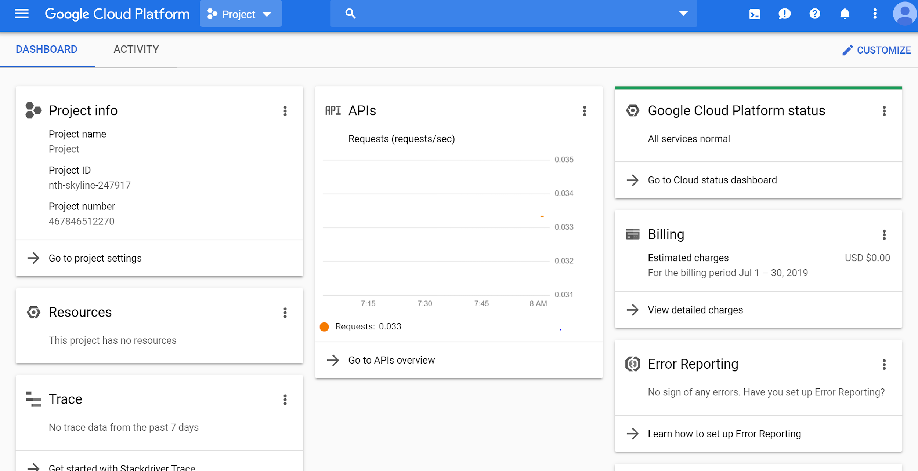
Creating a project
http://www.console.google.com
Copyright Google LLC. For educational purposes in accordance with the terms of use set forth on the program Website.
Notes:
To create a project, click on the name of the current project in the upper left portion of the screen.

Slide 17
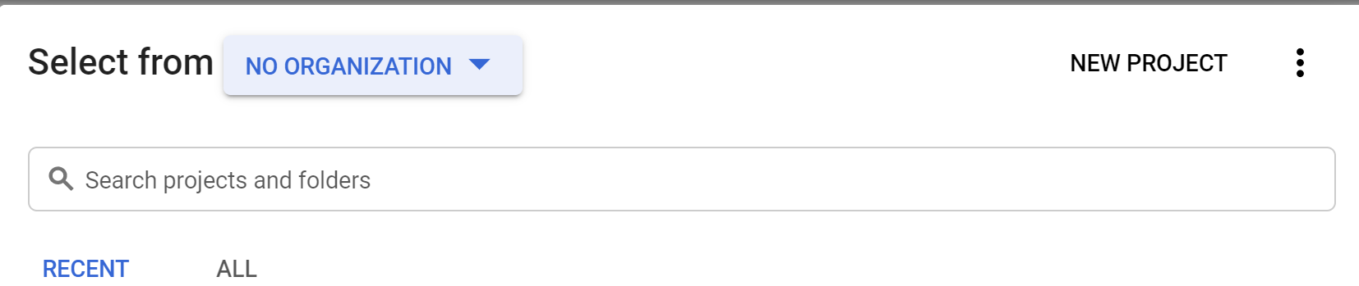
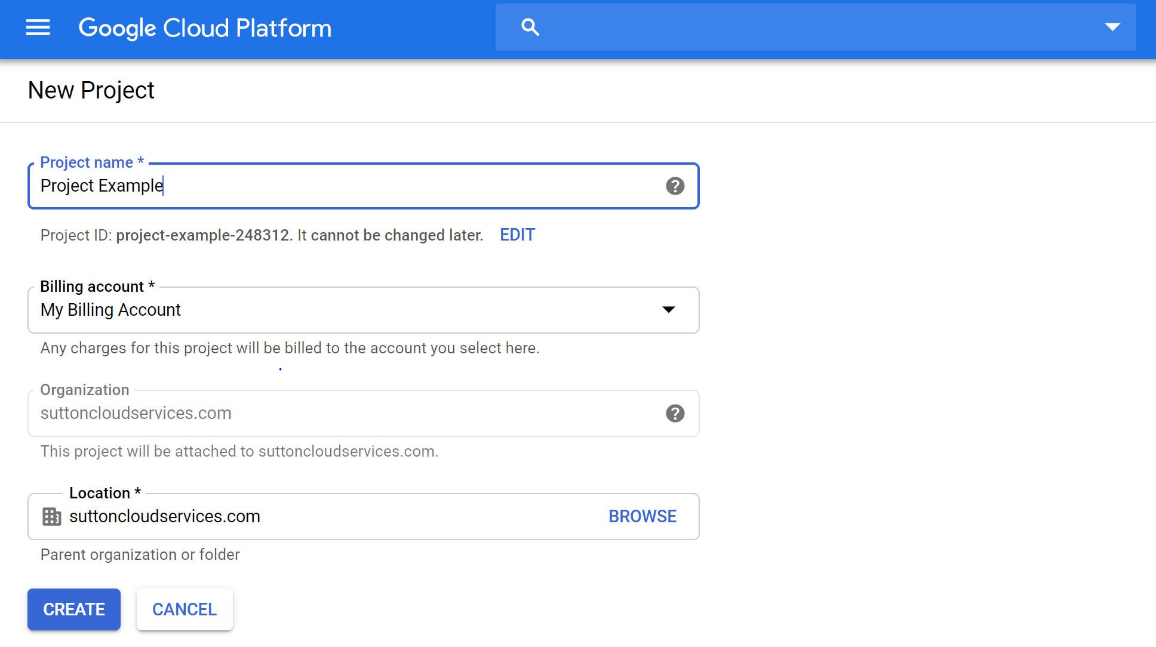
Creating a project
Copyright Google LLC. For educational purposes in accordance with the terms of use set forth on the program Website.
Notes:
A list of all current projects will be displayed. Select the New Project option on the right-hand side.
When the New Project screen is displayed, give your project a name. You have the option to use the auto-generated project ID, or create your own by clicking the Edit option. Project IDs must be globally unique. Select the appropriate billing account and organization and then click Create.

Slide 18
Agenda
The Cloud Console
Understanding Projects
Billing in Google Cloud
Install and Configure the Cloud SDK
Use Cloud Shell
Lab: A Tour of Qwiklabs and Google Cloud
Copyright Google LLC. For educational purposes in accordance with the terms of use set forth on the program Website.
Notes:
In the next topic, you’ll learn how billing works in Google Cloud.

Slide 19

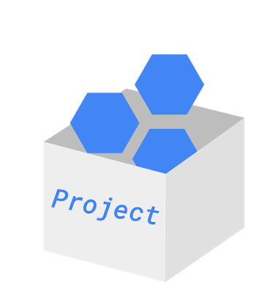
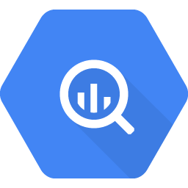
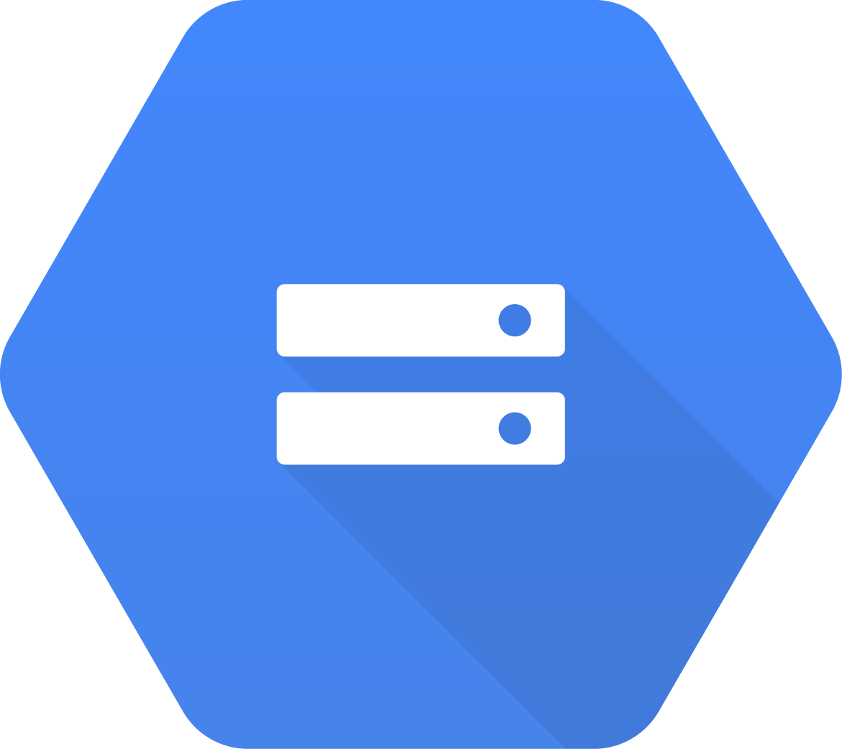
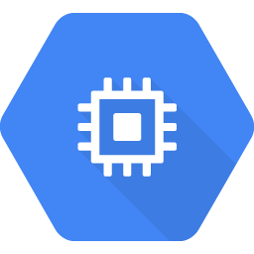
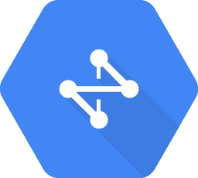
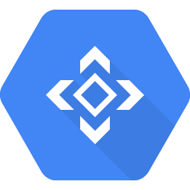
How billing works
Billing account pays for project resources.
A billing account is linked to zero or more projects.
Accounts are charged automatically, invoiced monthly, or invoiced at the threshold limit.
Sub accounts can be used for separate billing for projects.
BigQuery
Cloud Storage
VMs
Cloud Network
Cloud
APIs
Copyright Google LLC. For educational purposes in accordance with the terms of use set forth on the program Website.
Notes:
Billing in Google Cloud is set up at the Google Cloud project level. When you define a Google Cloud project, you link a billing account to it. This billing account is where you will configure all your billing information, including your payment option.
You can link your billing account to zero or more projects. Projects that you don’t link to any billing account can only use free Google Cloud services.
Your billing account can be charged automatically and invoiced every month, or at every threshold limit.
You can separate project billings by setting up billing subaccounts. Some Google Cloud customers who resell Google Cloud services use sub accounts for each of their own clients.

Slide 20
How to keep your billing under control
1
Budgets and alerts
2
Billing export
3
Reports
4
Quotas
Copyright Google LLC. For educational purposes in accordance with the terms of use set forth on the program Website.
Notes:
You’re probably thinking, “How can I make sure I don’t accidentally run up a big Google Cloud bill?” Google Cloud provides four tools to help:
Budgets and alerts,
Billing export,
Reports, and
Quotas.
We’ll discuss each of these in more detail next.

Slide 21
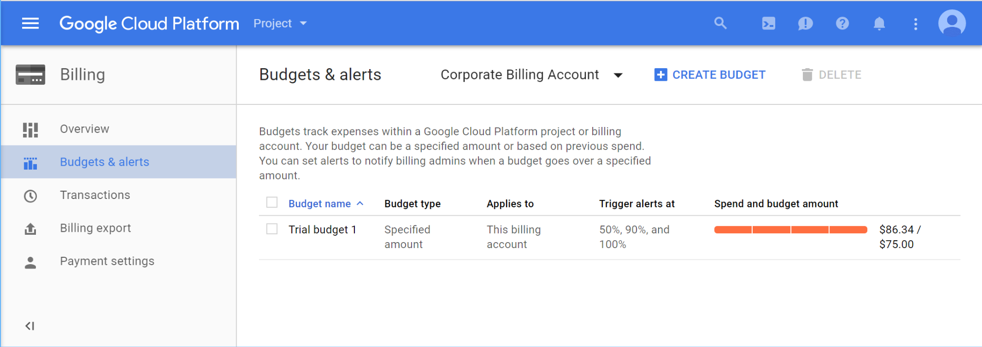
Budgets and alerts keep your billing under control
Copyright Google LLC. For educational purposes in accordance with the terms of use set forth on the program Website.
Notes:
You can define budgets at the billing account level or at the project level.
To be notified when costs approach your budget limit, you can create an alert. For example, with a budget limit of $20 and an alert set at 90%, you’ll receive a notification alert when your expenses reach $18.
You can also set up a webhook to be called in response to an alert. This webhook can control automation based on billing alerts. For example, you could trigger a script to shutdown resources when a billing alert occurs.

Slide 22
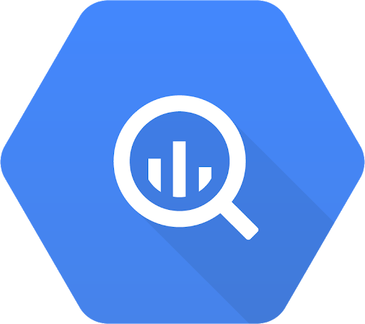
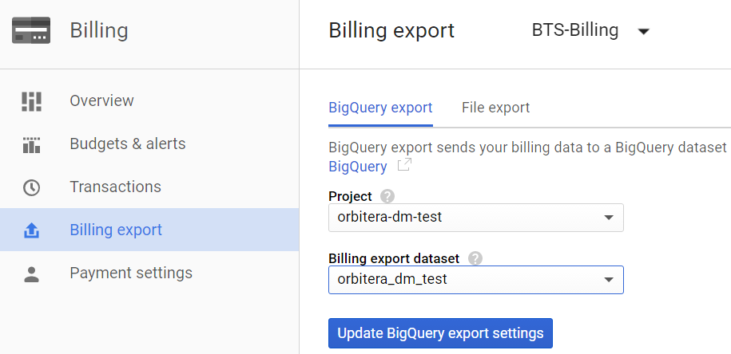
Billing export allows you to store detailed billing information
BigQuery
Cloud Storage
Copyright Google LLC. For educational purposes in accordance with the terms of use set forth on the program Website.
Notes:
Billing export allows you to store detailed billing information in places where it is easy to retrieve for external analysis, such as a BigQuery dataset or Cloud Storage bucket.

Slide 23
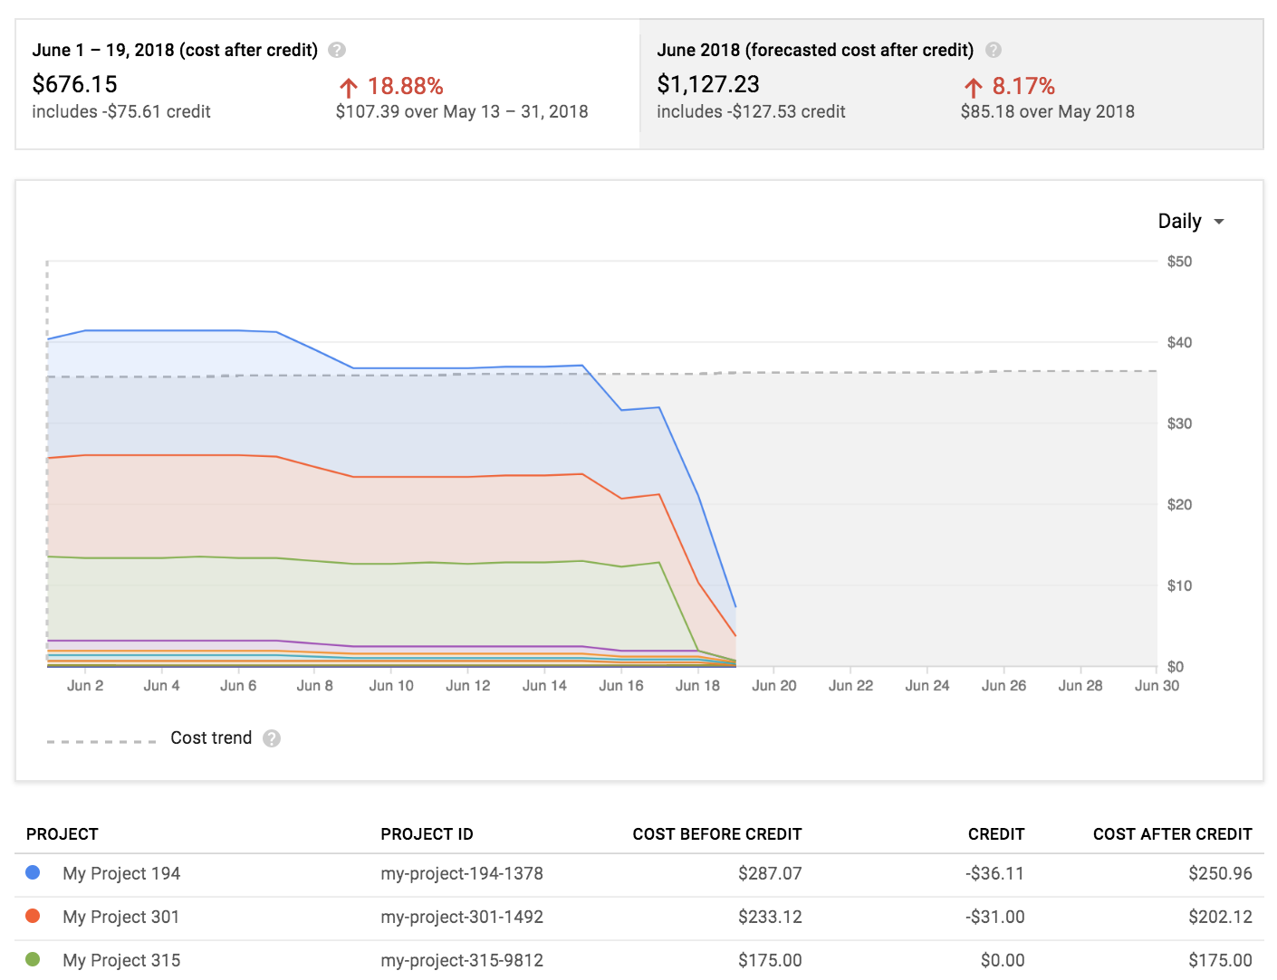
Reports is a visual tool to monitor expenditure
Copyright Google LLC. For educational purposes in accordance with the terms of use set forth on the program Website.
Notes:
And Reports is a visual tool in the Console that allows you to monitor expenditure based on a project or services.

Slide 24

Quotas are helpful limits
Rate quota
GKE API: 1,000 requests per 100 seconds
Allocation quota
5 networks per project
Many quotas are changeable
Copyright Google LLC. For educational purposes in accordance with the terms of use set forth on the program Website.
Notes:
Google Cloud also implements quotas, which limit unforeseen extra billing charges. Quotas are designed to prevent the over-consumption of resources because of an error or a malicious attack.
Quotas apply at the level of the Google Cloud project.
There are two types of quotas: rate quotas and allocation quotas. Rate quotas reset after a specific time. For example, by default, the Google Kubernetes Engine service implements a quota of 1,000 calls to its API from each Google Cloud project every 100 seconds.
Allocation quotas govern the number of resources you can have in your projects. For example, depending on the region, the number of GPUs permitted varies by type and region.
You can change quotas by requesting an increase from Google Cloud Support. You can also use the console to request a quota change.
Google Cloud quotas also protect the community of Google Cloud users by reducing the risk of unforeseen spikes in usage.

Slide 25
Agenda
The Cloud Console
Understanding Projects
Billing in Google Cloud
Install and Configure the Cloud SDK
Use Cloud Shell
Lab: A Tour of Qwiklabs and Google Cloud
Copyright Google LLC. For educational purposes in accordance with the terms of use set forth on the program Website.
Notes:
The Cloud Software Development Kit (SDK) enables a user to run Google Cloud command line tools from a local desktop. Installing and configuring the Cloud SDK is our next topic.

Slide 26
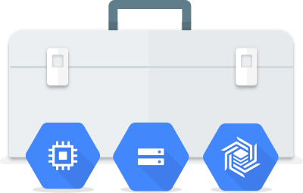
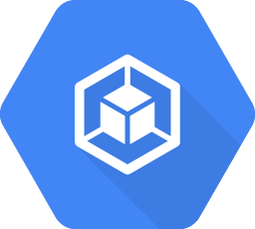
The Cloud SDK is a command-line interface for Google Cloud products and services
gcloud
gsutil
bq
Copyright Google LLC. For educational purposes in accordance with the terms of use set forth on the program Website.
Notes:
The Cloud SDK is a set of command-line tools that you can download and install onto a computer of your choice and use to manage resources and applications hosted on Google Cloud.
The gcloud ***gee cloud*** CLI manages authentication, local configuration, developer workflow, and interactions with Google Cloud APIs.
Gsutil ***gee ess util*** provides command line access to manage Cloud Storage buckets and objects.
bq *** bee cue*** allows you to run queries and manipulate datasets, tables, and entities in BigQuery through the command line.

Slide 27
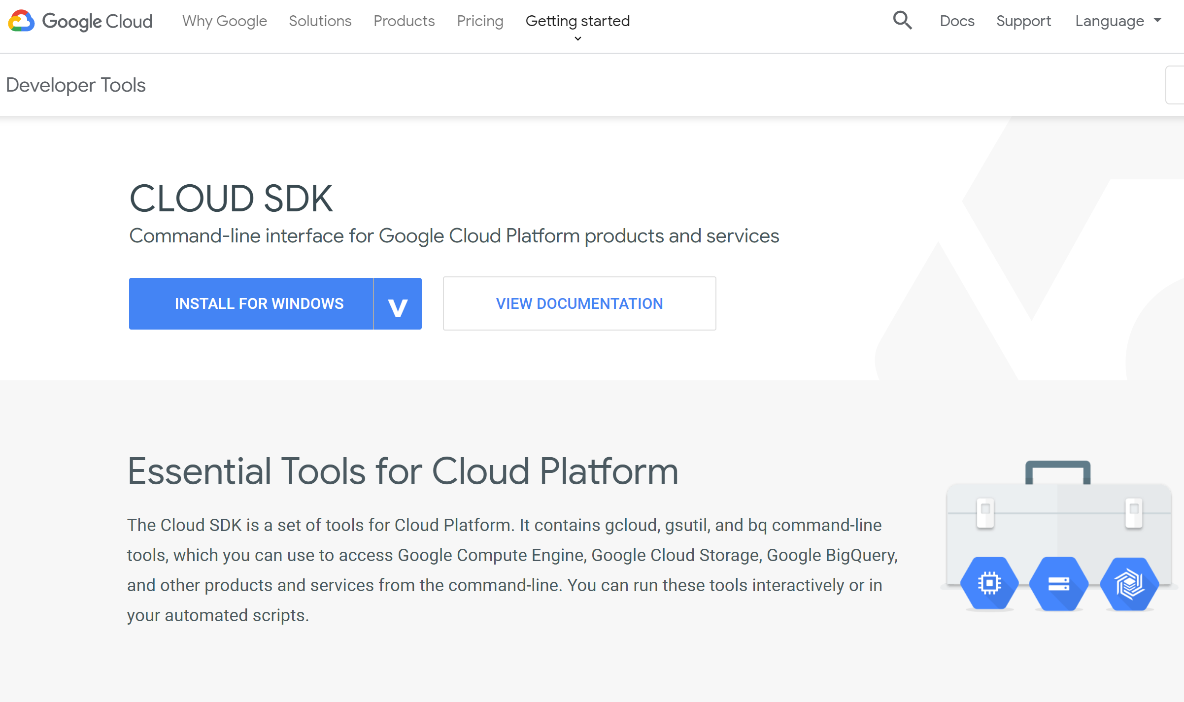
Installing the Cloud SDK
Copyright Google LLC. For educational purposes in accordance with the terms of use set forth on the program Website.
Notes:
To install the Cloud SDK to your desktop, go to cloud.google.com/sdk. Select the operating system for your desktop and this will download the SDK for your operating system on your desktop. Then follow the instructions specific to your operating system.

Slide 28
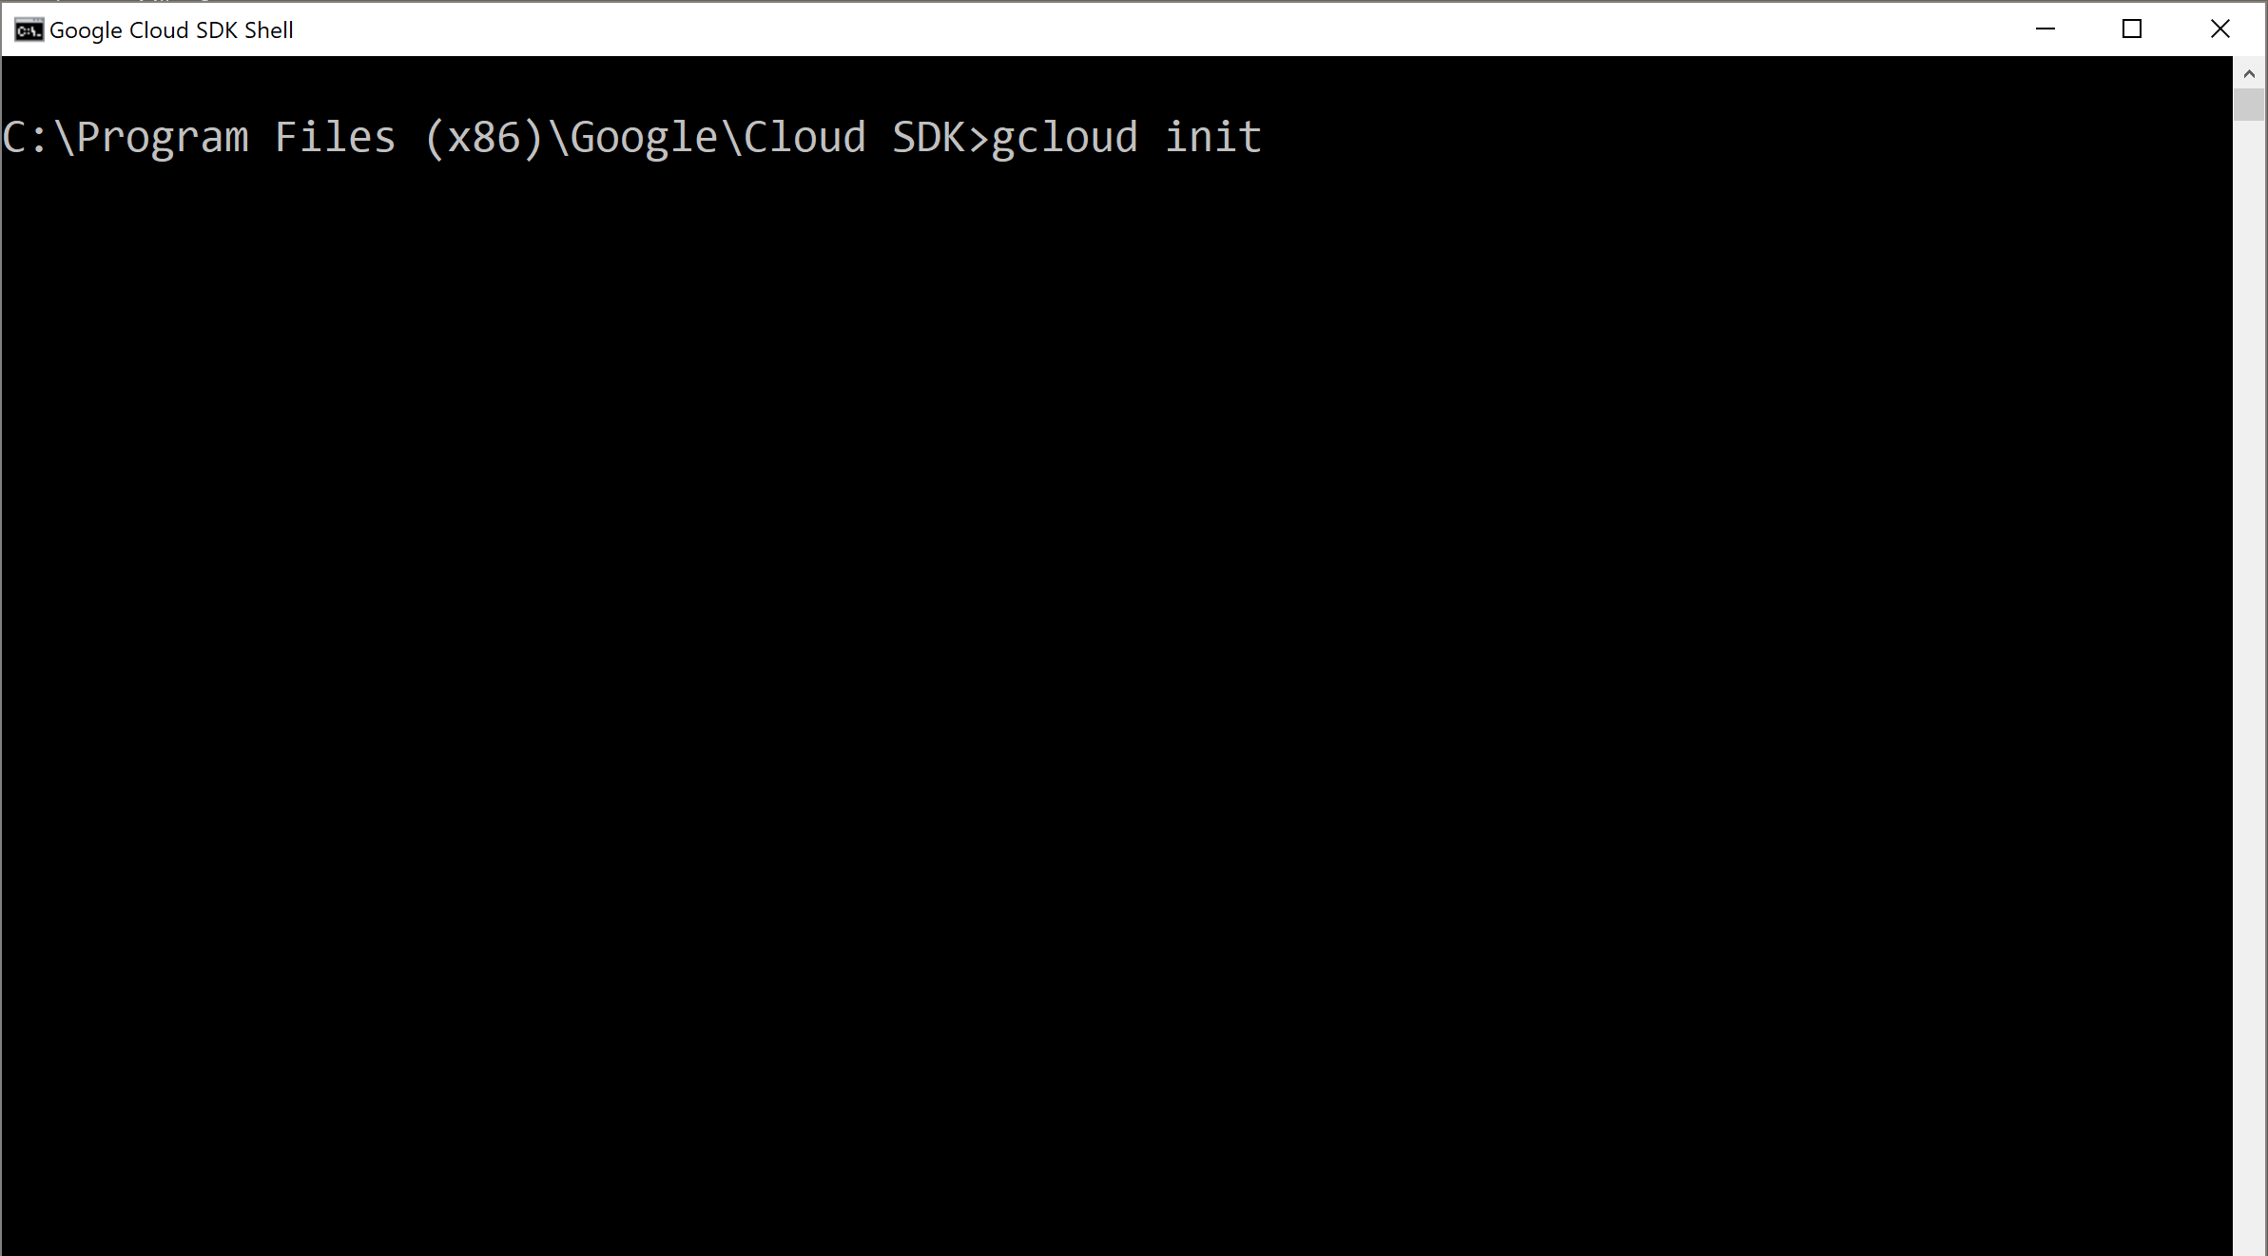
Configuring the Cloud SDK
Copyright Google LLC. For educational purposes in accordance with the terms of use set forth on the program Website.
Notes:
After the installation is complete, you will need to configure the Cloud SDK for your Google Cloud environment. Run the gcloud init ***gee cloud in it*** command. You will be prompted for information including your login credentials, default project, and default region and zone.

Slide 29
Agenda
The Cloud Console
Understanding Projects
Billing in Google Cloud
Install and Configure the Cloud SDK
Use Cloud Shell
Lab: A Tour of Qwiklabs and Google Cloud
Copyright Google LLC. For educational purposes in accordance with the terms of use set forth on the program Website.
Notes:
Cloud Shell allows a user to run the Google command line without installing the Cloud SDK on a desktop. In this topic, we’ll learn how to utilize Cloud Shell.

Slide 30
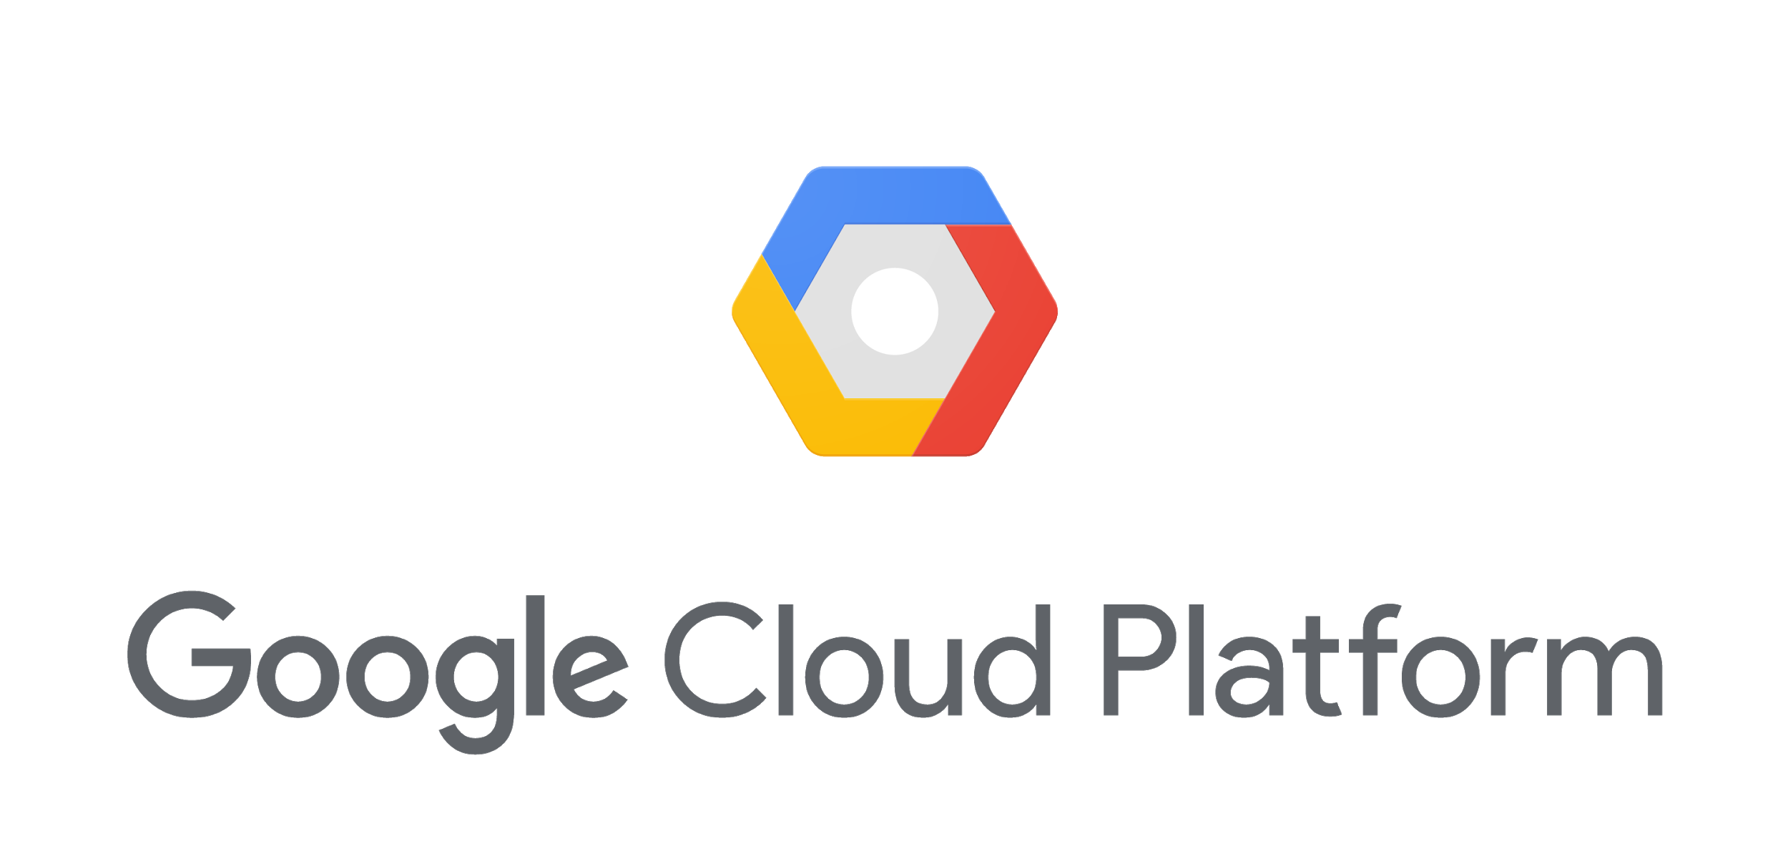
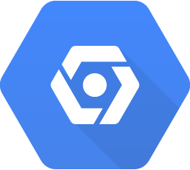
Cloud Shell is an alternative to the Cloud SDK
Cloud Console
console.cloud.google.com
Browser-based CLI access to resources
No need to install the Cloud SDK or other tools locally
Runs on an ephemeral Compute Engine VM at no cost to you
5 GB of persistent disk storage
Web preview functionality and built-in authorization for project/resource access
Cloud Shell
Cloud SDK
Copyright Google LLC. For educational purposes in accordance with the terms of use set forth on the program Website.
Notes:
Using Cloud Shell, you can manage your projects and resources easily without having to install the Cloud SDK or other tools locally. The Cloud SDK command-line tools and other utilities are always available, up to date, and fully authenticated.
Your Cloud Shell virtual machine is ephemeral, which means that it will be stopped whenever you stop using it interactively, and it’ll be restarted when you re-enter Cloud Shell. You get five gigabytes of persistent disk storage that is reattached for you every time a new Cloud Shell session is started.
Cloud Shell provides web preview functionality and built-in authorization for access to Cloud Console projects and resources.

Slide 31
Starting Cloud Shell
Copyright Google LLC. For educational purposes in accordance with the terms of use set forth on the program Website.
Notes:
To start Cloud Shell, click on the Activate Cloud Shell icon in the upper right side of the screen.

Slide 32
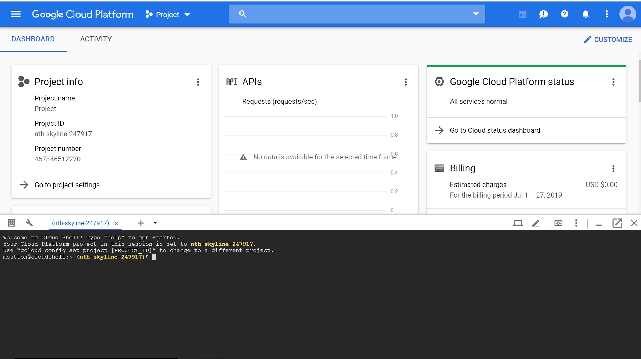
The Cloud Console and Cloud Shell
Copyright Google LLC. For educational purposes in accordance with the terms of use set forth on the program Website.
Notes:
The Cloud Shell terminal will appear on the lower portion of the window. Options, including launching the Cloud Shell code editor and opening Cloud Shell in a new page, can be performed using the tool bar on the upper right corner of Cloud Shell.

Slide 33
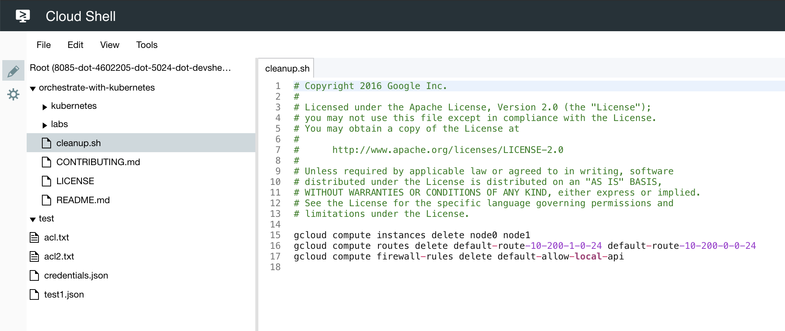
The Cloud Shell code editor is a tool for editing files inside your Cloud Shell environment
Copyright Google LLC. For educational purposes in accordance with the terms of use set forth on the program Website.
Notes:
The Cloud Shell code editor is a tool for editing files inside your Cloud Shell environment in real time within the web browser. This tool is extremely convenient when working with code-first applications or container-based workloads, because you can edit files easily without the need to download and upload changes. You can also use text editors from the Cloud Shell command prompt.

Slide 34
Agenda
The Cloud Console
Understanding Projects
Billing in Google Cloud
Install and Configure the Cloud SDK
Use Cloud Shell
Lab: A Tour of Qwiklabs and Google Cloud
Copyright Google LLC. For educational purposes in accordance with the terms of use set forth on the program Website.
Notes:
You’ll now get the chance to complete your first hands-on lab on the course.

Slide 35
Lab Intro
A Tour of Qwiklabs and Google Cloud
Access the Qwiklabs environment and log in to the Cloud Console using custom credentials.
The lab can be found here.
Copyright Google LLC. For educational purposes in accordance with the terms of use set forth on the program Website.
Notes:
For our first lab, you will take your first steps with Google Cloud by getting hands-on practice with the Cloud Console, the in-browser UI that lets you access and manage Google Cloud services. You will identify key features of Google Cloud and also learn the ins and outs of the Qwiklabs environment.

Slide 36
Lab objectives
Learn about the Qwiklabs platform and identify key features of a lab environment.
Learn how to access the Cloud Console with specific credentials.
Copyright Google LLC. For educational purposes in accordance with the terms of use set forth on the program Website.
Notes:
By completing this lab, you’ll learn how to identify the key features of Qwiklabs, and how to access the Cloud Console.

Slide 37
Agenda
Lab: Getting Started with Cloud Shell and gcloud
Google Cloud APIs
Cloud Console Mobile App
Quiz
Summary
Copyright Google LLC. For educational purposes in accordance with the terms of use set forth on the program Website.
Notes:
In this second lab, you’ll run a series of gcloud commands with Cloud Shell.

Slide 38
Lab Intro
Getting Started with Cloud Shell and gcloud
Connect to computing resources hosted on Google Cloud via Cloud Shell with the gcloud command-line.
The lab can be found here.
Copyright Google LLC. For educational purposes in accordance with the terms of use set forth on the program Website.
Notes:
In this hands-on lab you will learn how to connect to computing resources hosted on Google Cloud via Cloud Shell with the gcloud command-line.

Slide 39
Lab objectives
Practice using gcloud commands.
Connect to storage services hosted on Google Cloud.
Copyright Google LLC. For educational purposes in accordance with the terms of use set forth on the program Website.
Notes:
After the lab is completed, you should have a better understanding of how to use gcloud commands, and how to connect to storage services hosted on Google Cloud.

Slide 40
Agenda
Lab: Getting Started with Cloud Shell and gcloud
Google Cloud APIs
Cloud Console Mobile App
Quiz
Summary
Copyright Google LLC. For educational purposes in accordance with the terms of use set forth on the program Website.
Notes:
Everything we do in Google Cloud is done with APIs. In this topic, we’ll introduce APIs and discuss how they’re used.

Slide 41
APIs hide the details and enforce contracts
Users
Complex, changeable implementation
API
Simple, versioned interface
Copyright Google LLC. For educational purposes in accordance with the terms of use set forth on the program Website.
Notes:
Let’s be precise about what an Application Programming Interface, or API, is. A software service’s implementation can be complex and changeable. If other software services had to be explicitly coded at that level of detail in order to use that service, the result would be brittle and error-prone. So instead, application developers structure the software they write so that it presents a clean, well-defined interface that abstracts away needless detail, and then they document that interface. That’s an Application Programming Interface. The underlying implementation can change, as long as the interface doesn’t, and other pieces of software that use the API don’t have to know or care.

Slide 42
The services that make up Google Cloud offer APIs so that you can write code to control them
RESTful APIs are enabled through the Cloud Console.
Programmatic access is provided to products and services.
Code typically uses JSON as an interchange format.
Use OAuth 2.0 for authentication and authorization.
To help you control spend, most include daily quotas and rates (limits). Quotas and rates can be raised by request.
Copyright Google LLC. For educational purposes in accordance with the terms of use set forth on the program Website.
Notes:
These APIs are what’s called “RESTful”; in other words, they follow the “REpresentation State Transfer” paradigm.
In a broad sense, that means that your code can use Google services in much the same way that web browsers talk to web servers. The APIs identify resources in Google Cloud with URLs. Your code can pass information to the APIs using JSON, which is a very popular way of passing textual information over the Web. And there’s an open system, OAuth2, for user login and access control.
Google Cloud APIs also assist in helping you to control your spend, with most including daily quotas and limits. Where needed, quotas and rates can be raised by request.

Slide 43
Use client libraries to create and manage resources
RESTful API
GET, POST, PUT, DELETE
JSON
OAuth 2 is used for all authentication.
Cloud Client Libraries
Cloud SDK
Languages
Java
Python
NodeJS
gcloud
gsutil
CLI tools
bq
Ruby
Go
PHP
Copyright Google LLC. For educational purposes in accordance with the terms of use set forth on the program Website.
Notes:
In addition to the Cloud SDK, you will also use client libraries that enable you to easily create and manage resources. Google Cloud client libraries expose APIs for two main purposes:
App APIs provide access to services and they are optimized for supported languages, such as Node.js and Python.
Admin APIs offer functionality for resource management. For example, you can use admin APIs if you want to build your own automated tools.
We discuss the different application managed service options in more detail later in the course.

Slide 44
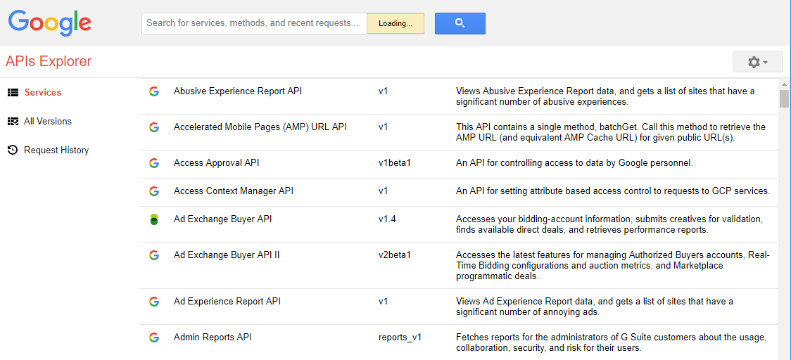
Use the Google APIs Explorer to help you write
your code
Copyright Google LLC. For educational purposes in accordance with the terms of use set forth on the program Website.
Notes:
The Cloud Console includes a tool called the APIs Explorer that helps you learn about the APIs interactively. It lets you see what APIs are available, and in what versions. These APIs expect parameters, and documentation on them is built-in. You can try the APIs interactively, even with user authentication.
Suppose you’ve explored an API, and you’re ready to build an application that uses it. Do you have to start coding from scratch? No. Google provides client libraries to take a lot of the drudgery out of the task of calling Google Cloud from your code.

Slide 45
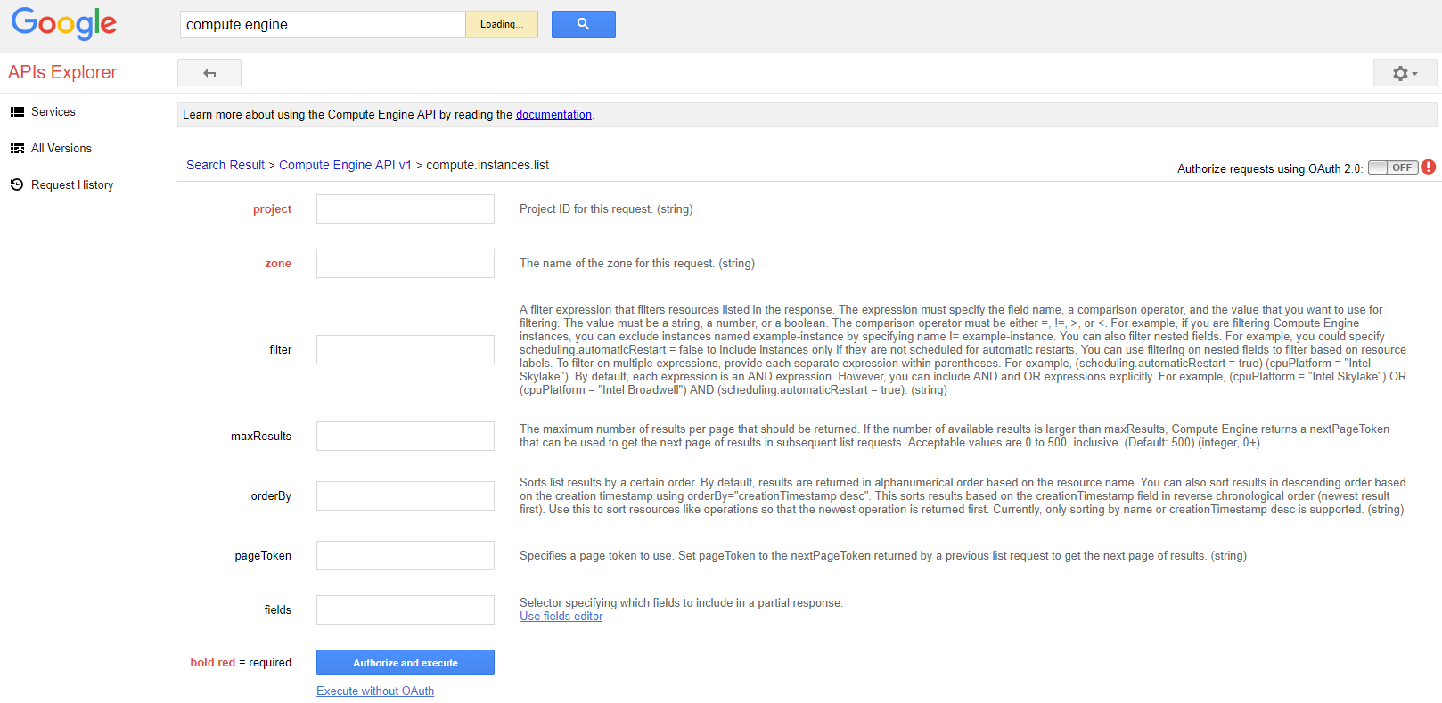
Testing an API
Copyright Google LLC. For educational purposes in accordance with the terms of use set forth on the program Website.
Notes:
In this example, the compute.instances.list method from the Compute Engine API will be tested. Items listed in red are required inputs. When the method is run, you will have to log in using OAuth 2.0. Since REST APIs are HTTP based, if the method runs correctly you will receive a 200 message and the appropriate data will be displayed. If the project or the zone were entered incorrectly, you will get a 400 error and no data will be displayed.

Slide 46
Agenda
Lab: Getting Started with Cloud Shell and gcloud
Google Cloud APIs
Cloud Console Mobile App
Quiz
Summary
Copyright Google LLC. For educational purposes in accordance with the terms of use set forth on the program Website.
Notes:
The Cloud Console mobile app provides another way for you to manage services running on Google Cloud - directly from your mobile device. It’s a convenient resource that doesn’t cost anything extra.

Slide 47
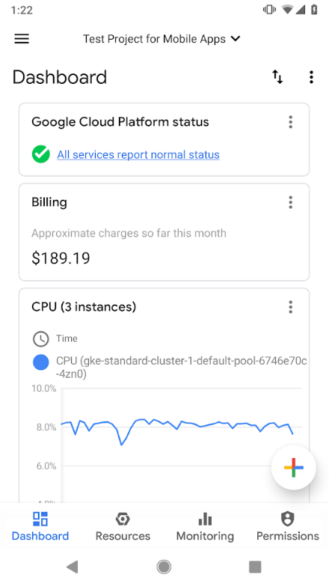
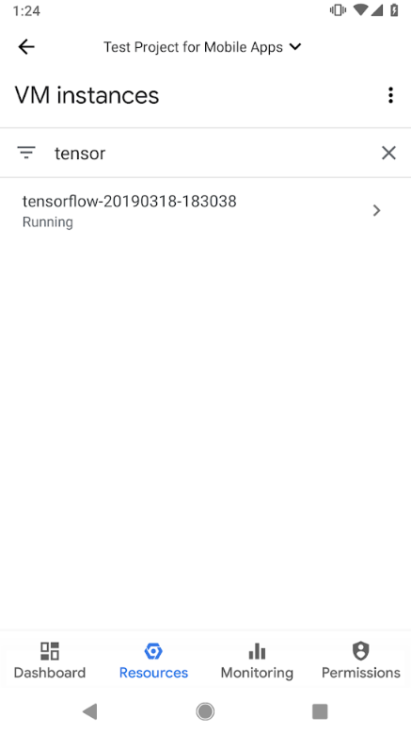
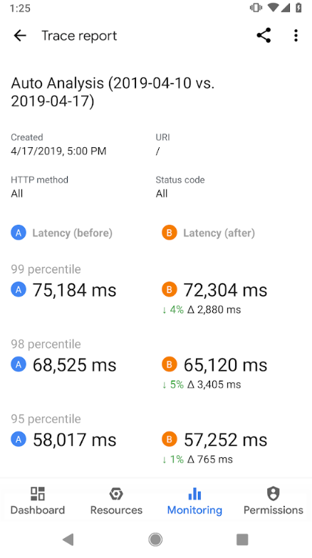
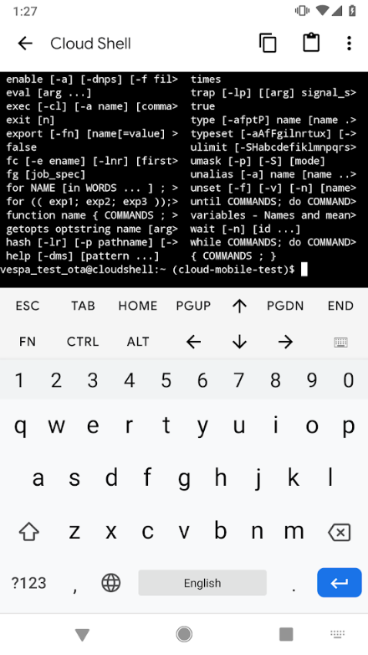
Manage Google Cloud services from your Android or iOS device
Copyright Google LLC. For educational purposes in accordance with the terms of use set forth on the program Website.
Notes:
The Cloud Console mobile app is available for iOS and Android and offers many capabilities.
It allows you to stay connected to the cloud and check billing, status, and critical issues. To see the health of your service at a glance, you can create your own custom dashboard showing key metrics such as CPU usage, network usage, requests per second, server errors, and more.
You can take action to address issues directly from your device such as rolling back a bad release, stopping or restarting a virtual machine, searching logs or even connecting to a virtual machine via SSH.
The monitoring functionality allows you to view and respond to to incidents, errors, and logging. If you need to, you can even access Cloud Shell to perform any gcloud operation.

Slide 48
Agenda
Lab: Getting Started with Cloud Shell and gcloud
Google Cloud APIs
Cloud Console Mobile App
Quiz
Summary
Copyright Google LLC. For educational purposes in accordance with the terms of use set forth on the program Website.
Notes:
For our final topic of the module, let's test what we learned with a quick quiz.

Slide 49
Scenario #1
Question
True or False: All Google Cloud resources must be associated with a project.
True
False
Copyright Google LLC. For educational purposes in accordance with the terms of use set forth on the program Website.
Notes:
True or False, All Google Cloud resources must be associated with a project.

Slide 50
Scenario #1
Answer
True or False: All Google Cloud resources must be associated with a project.
True
False
Copyright Google LLC. For educational purposes in accordance with the terms of use set forth on the program Website.
Notes:
The answer is True. Associating all resources with a project helps with billing and isolation.

Slide 51
Scenario #2
Question
Which of the following is a command line tool that is part of the Cloud SDK?
Git
Bash
Gsutil
ssh
Copyright Google LLC. For educational purposes in accordance with the terms of use set forth on the program Website.
Notes:
Which of the following is a command line tool that is part of the Cloud SDK?

Slide 52
Scenario #2
Answer
Which of the following is a command line tool that is part of the Cloud SDK?
Git
Bash
Gsutil
ssh
Copyright Google LLC. For educational purposes in accordance with the terms of use set forth on the program Website.
Notes:
C is the correct answer. The gsutil command line tool is used to work with Cloud Storage.

Slide 53
Scenario #3
Question
What command would you use to set up the default configuration of the Cloud SDK?
gcloud compute
gsutil mb
bq run
gcloud init
Copyright Google LLC. For educational purposes in accordance with the terms of use set forth on the program Website.
Notes:
What command would you use to set up the default configuration of the Cloud SDK?

Slide 54
Scenario #3
Answer
What command would you use to set up the default configuration of the Cloud SDK?
gcloud compute
gsutil mb
bq run
gcloud init
Copyright Google LLC. For educational purposes in accordance with the terms of use set forth on the program Website.
Notes:
The gcloud init command is used to set up the user, default project, and the default region and zone of the Cloud SDK.

Slide 55
Agenda
Lab: Getting Started with Cloud Shell and gcloud
Google Cloud APIs
Cloud Console Mobile App
Quiz
Summary
Copyright Google LLC. For educational purposes in accordance with the terms of use set forth on the program Website.
Notes:
That concludes the ‘Start with a Solid Platform’ module. Let me remind you of what you learned.

Slide 56
Summary (1/2)
The Cloud Console provides a web-based GUI for you to manage your Google Cloud projects and resources.
All Google Cloud services you use are associated with a project.
Your billing account pays for resources at a project level. Google Cloud also implements quotas, which limit unforeseen extra billing charges.
The Cloud SDK is a command-line interface for Google Cloud products and services.
Cloud Shell is an alternative to the Cloud SDK and provides CLI access to cloud resources from within your browser.
Copyright Google LLC. For educational purposes in accordance with the terms of use set forth on the program Website.
Notes:
At the start of this module, we learned how the Cloud Console provides a web-based GUI to assist in managing Google Cloud projects and resources.
Next, we learned how all Google Cloud resources must be associated with a project.
And also how we can set up billing accounts at the project level. Quotas also help prevent billing surprises by putting a cap on resources.
We then learned how to leverage the Cloud SDK as a way to interface with Google Cloud products and services.
We also discussed Cloud Shell as an alternative to installing the Cloud SDK on our desktops.

Slide 57
Summary (2/2)
The services that make up Google Cloud offer APIs so that code you write can control them.
The Cloud Console includes a tool called the APIs Explorer that helps you learn about APIs interactively.
The Cloud Console mobile app allows you to manage services running on Google Cloud directly from your mobile device.
Copyright Google LLC. For educational purposes in accordance with the terms of use set forth on the program Website.
Notes:
We also discussed how to use Google Cloud services via APIs in code.
And how to test the APIs using APIs Explorer.
We finished up the module by discussing the Cloud Console mobile app, which allows the user to manage services on Google Cloud from a mobile device.

